Slide 1
Website Monitoring
Lecturer: Ngo Huy Bien
Software Engineering Department
Faculty of Information Technology
University of Science
Ho Chi Minh City, Vietnam
nhbien@fit.hcmus.edu.vn

Slide 2

Objectives

Slide 3

Contents

Slide 4

References

Slide 5
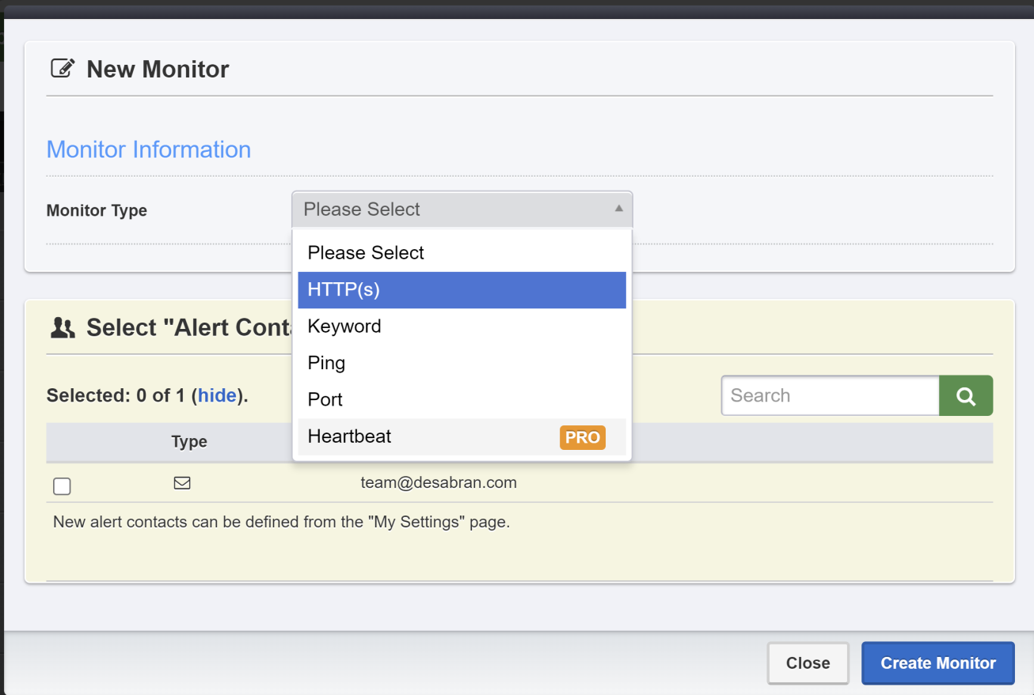
UptimeRobot
https://uptimerobot.com/

Slide 6
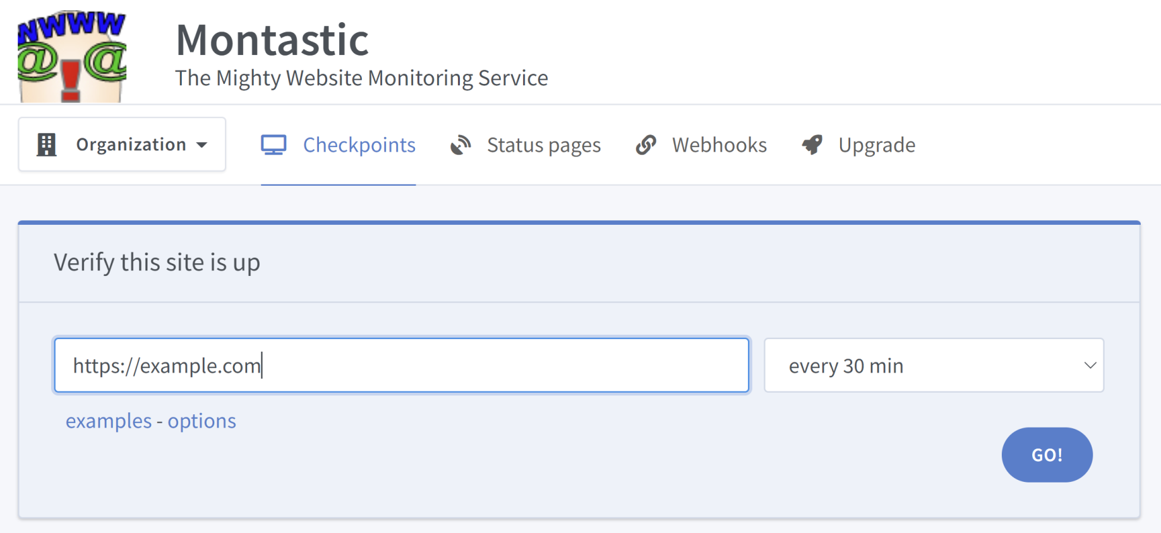
Montastic
https://www.montastic.com/

Slide 7

Further Reading

Slide 8

Thank You & See You Again

